Slide 1

Database Systems: Design, Implementation, and Management Ninth Edition
Chapter 3
The Relational Database Model
Last Revision: 07.11.2023

Slide 2
Objectives
In this chapter, students will learn:
That the relational database model offers a logical view of data
About the relational model’s basic component: relations
That relations are logical constructs composed of rows (tuples) and columns (attributes)
That relations are implemented as tables in a relational DBMS
About relational database operators, the data dictionary, and the system catalog
How data redundancy is handled in the relational database model
Why indexing is important

Slide 3
A Logical View of Data
Relational model
View data logically rather than physically
Table
Structural and data independence
Resembles a file conceptually
Relational database model is easier to understand than hierarchical and network models

Slide 4
Tables and Their Characteristics
Logical view of relational database is based on relation
Relation thought of as a table
Table: two-dimensional structure composed of rows and columns
Persistent representation of logical relation
Contains group of related entities (entity set)

Slide 5
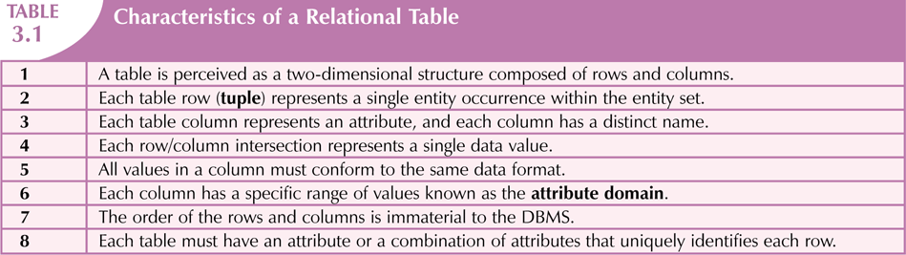

Slide 6
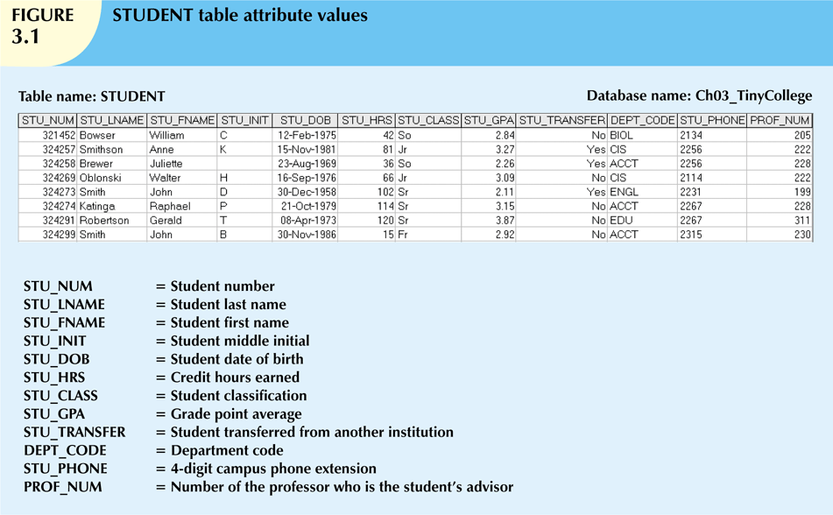

Slide 7
Keys
Each row in a table must be uniquely identifiable
Key is one or more attributes that determine other attributes
Key’s role is based on determination
If you know the value of attribute A, you can determine the value of attribute B
Functional dependence
Attribute B is functionally dependent on A if all rows in table that agree in value for A also agree in value for B

Slide 8
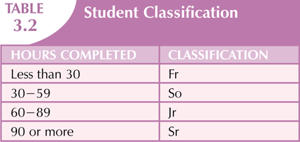

Slide 9
Keys (cont’d.)
Composite key
Composed of more than one attribute
Key attribute
Any attribute that is part of a key
Superkey
Any key that uniquely identifies each row
Candidate key
A superkey without unnecessary attributes

Slide 10
Keys (cont’d.)
Nulls
No data entry
Not permitted in primary key
Should be avoided in other attributes
Can represent:
An unknown attribute value
A known, but missing, attribute value
A “not applicable” condition

Slide 11
Keys (cont’d.)
Nulls (cont’d.)
Can create problems when functions such as COUNT, AVERAGE, and SUM are used
Can create logical problems when relational tables are linked

Slide 12
Keys (cont’d.)
Controlled redundancy
Makes the relational database work
Tables within the database share common attributes
Enables tables to be linked together
Multiple occurrences of values not redundant when required to make the relationship work
Redundancy exists only when there is unnecessary duplication of attribute values

Slide 13
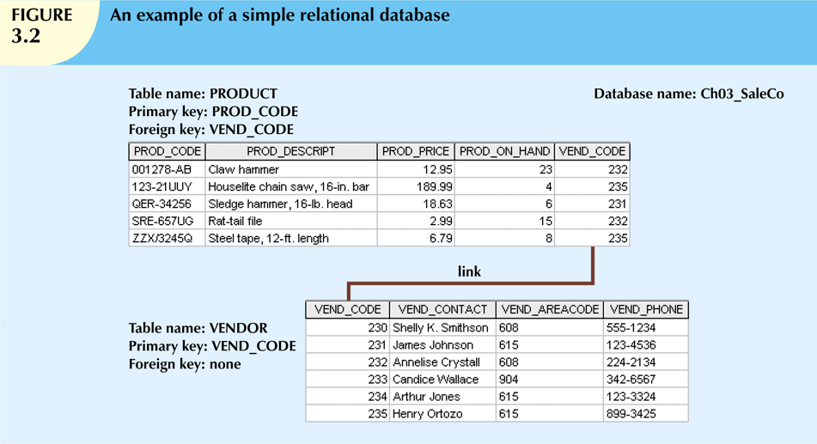

Slide 14
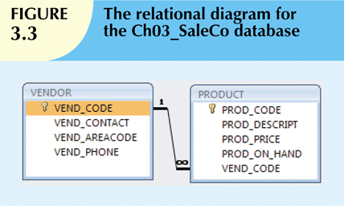

Slide 15
Keys (cont’d.)
Foreign key (FK)
An attribute whose values match primary key values in the related table
Referential integrity
FK contains a value that refers to an existing valid tuple (row) in another relation
Secondary key
Key used strictly for data retrieval purposes

Slide 16
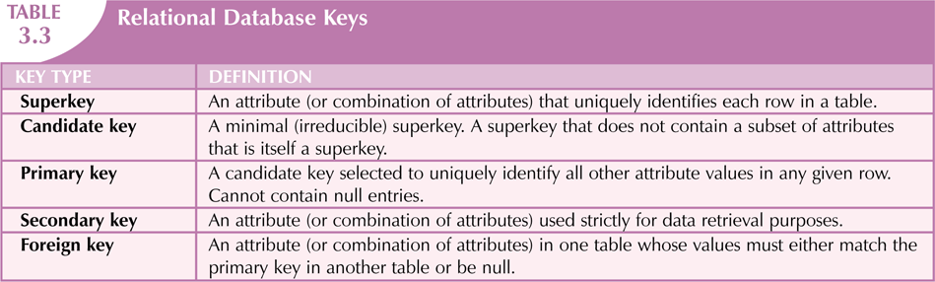

Slide 17
Integrity Rules
Many RDBMs enforce integrity rules automatically
Safer to ensure that application design conforms to entity and referential integrity rules
Designers use flags to avoid nulls
Flags indicate absence of some value

Slide 18
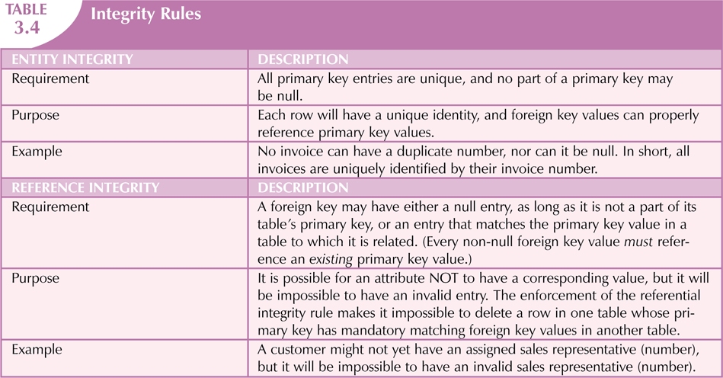


Slide 19
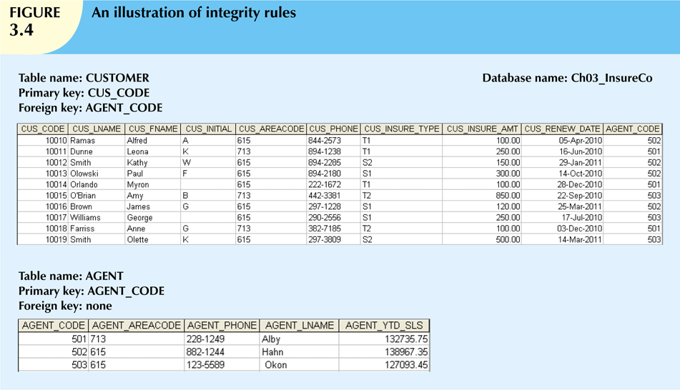

Slide 20
Relational Set Operators
Relational algebra
Defines theoretical way of manipulating table contents using relational operators
To be considered minimally relational, the DBMS must support the key relational operators SELECT, PROJECT and JOIN. Very few DBMSs are capable of supporting all eight relational operators.
Use of relational algebra operators on existing relations produces new relations:
SELECT | DIFFERENCE
PROJECT | JOIN
UNION | PRODUCT
INTERSECT | DIVIDE

Slide 21
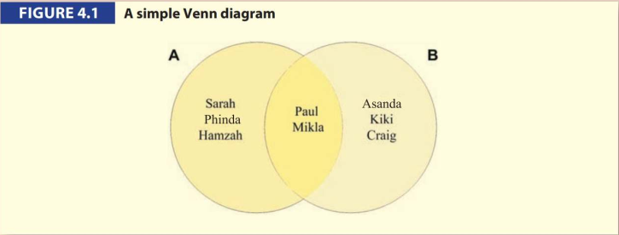
SET THEORY
Set theory is one of the most fundamental concepts in mathematics. The theory is based on the idea that elements have membership in a set.

Slide 22
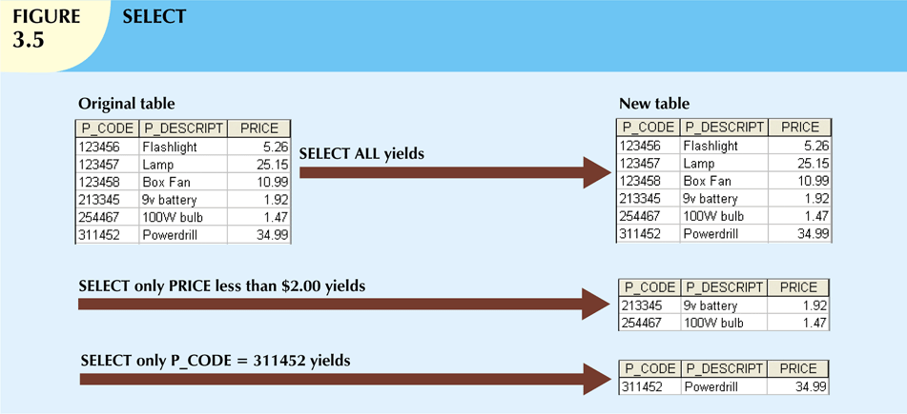
SELECT (aka RESTRICT)
The relational operator SELECT, also known as RESTRICT, can be used to list all of the row values, or it can return only those row values that match a specified criterion. In other words, SELECT returns a horizontal subset of a relation.

Slide 23
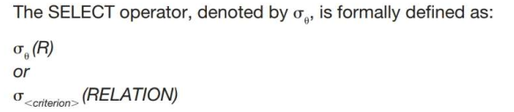
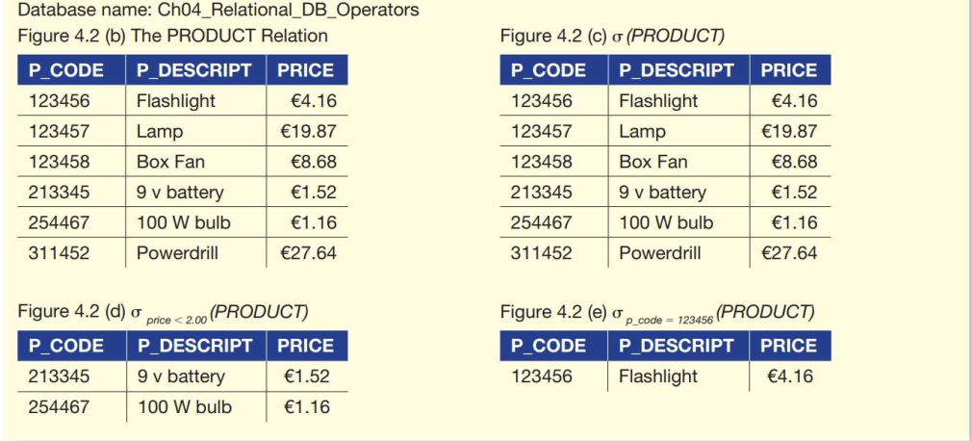
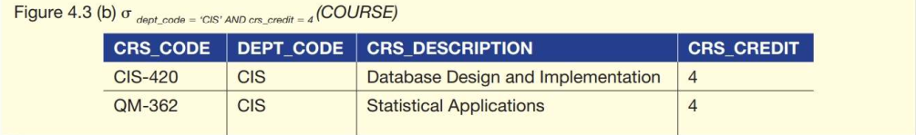
SELECT

Slide 24
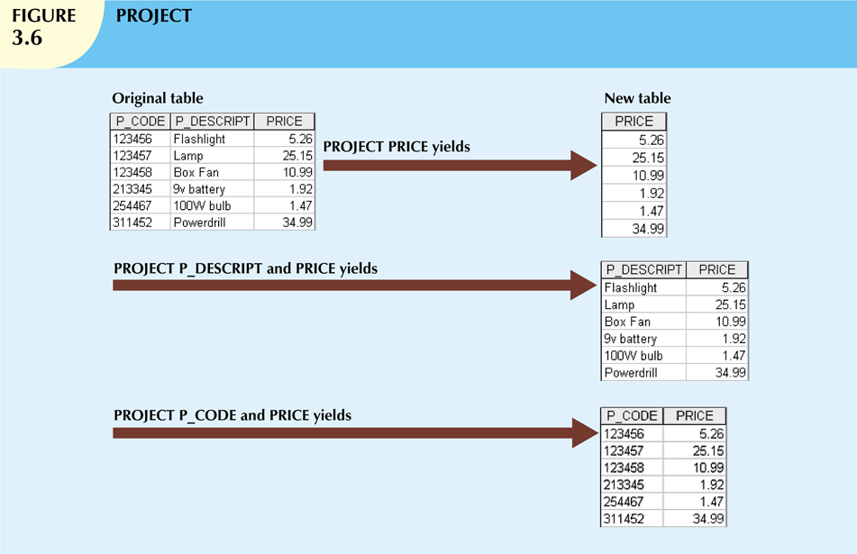
PROJECT
defined as
The PROJECT operator returns all values for selected attributes. In other words, PROJECT returns a vertical subset of a relation excluding any duplicates.

Slide 25
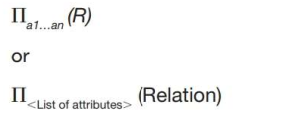
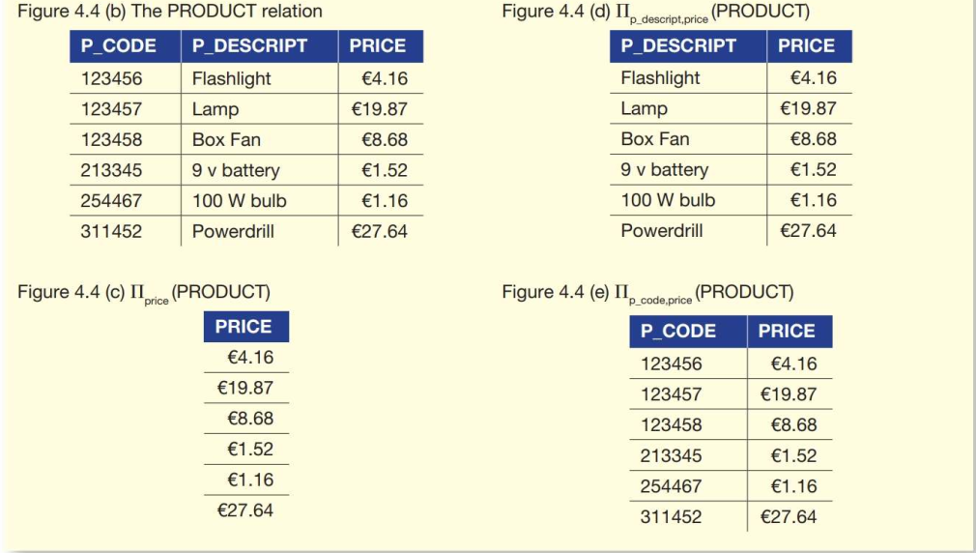
PROJECT
The PROJECT operator, denoted by Π, is formally defined as:
Select column_name from table_name

Slide 26
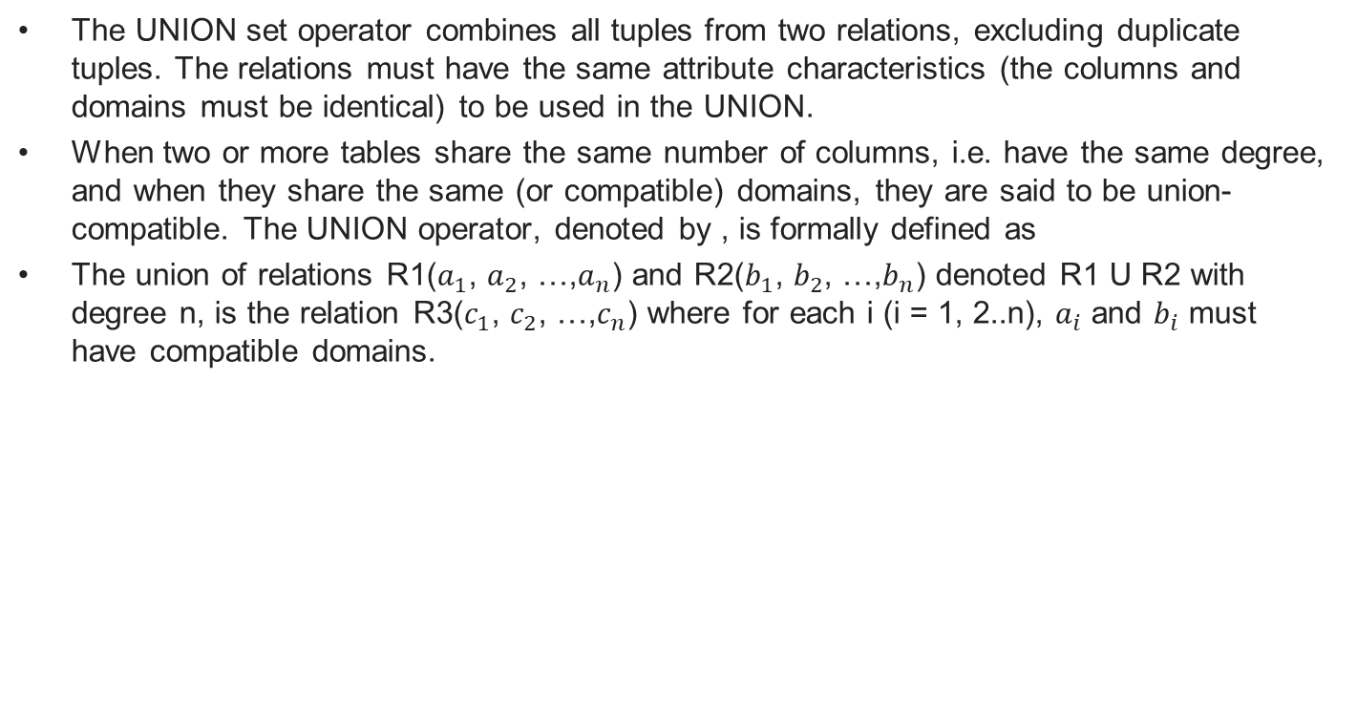
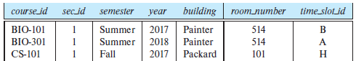
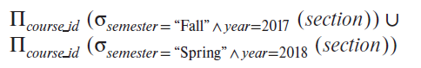
UNION

Slide 27
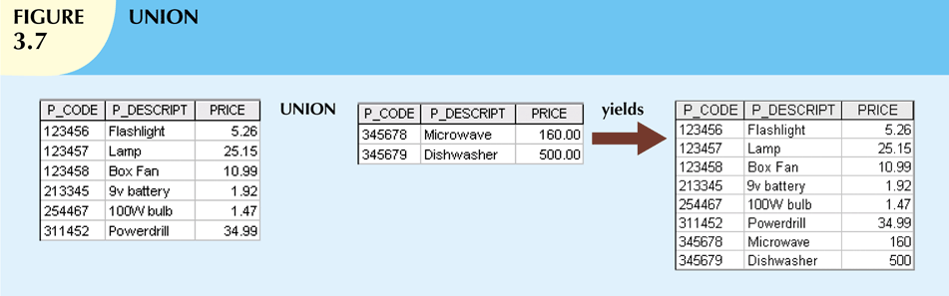
UNION
Two relation instances are said to be union-compatible if;
they have the same number of the fields, and
corresponding fields, taken in order from left to right, have the same
domains.
SELECT column_name(s) FROM table1 UNION SELECT column_name(s) FROM table2;

Slide 28
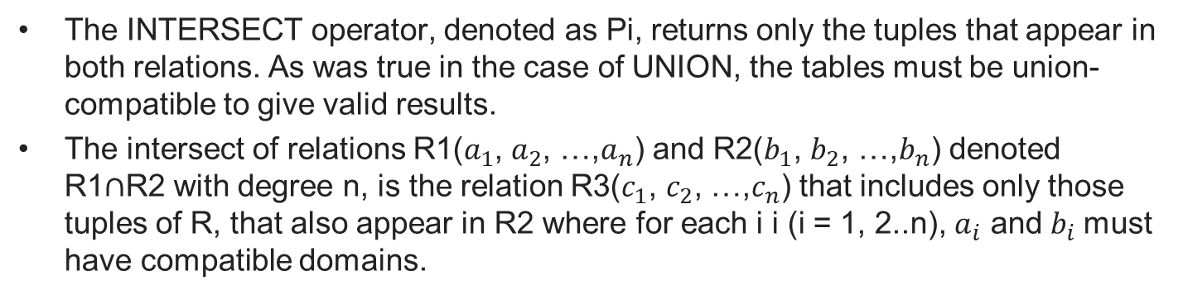
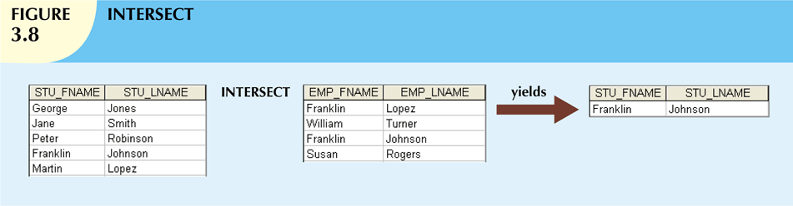
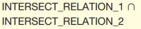
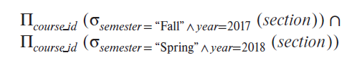
INTERSECT
SELECT NAME, AGE, HOBBY FROM STUDENTS WHERE AGE BETWEEN 25 AND 30
INTERSECT
SELECT NAME, AGE, HOBBY FROM ASSOCIATES WHERE AGE BETWEEN 20 AND 30

Slide 29
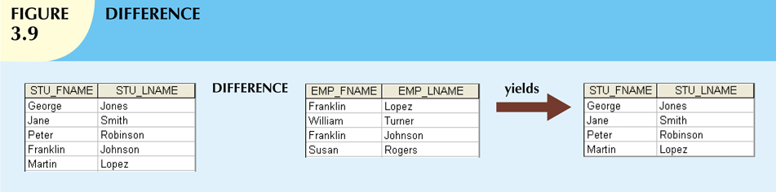
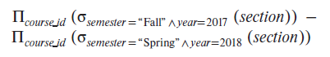
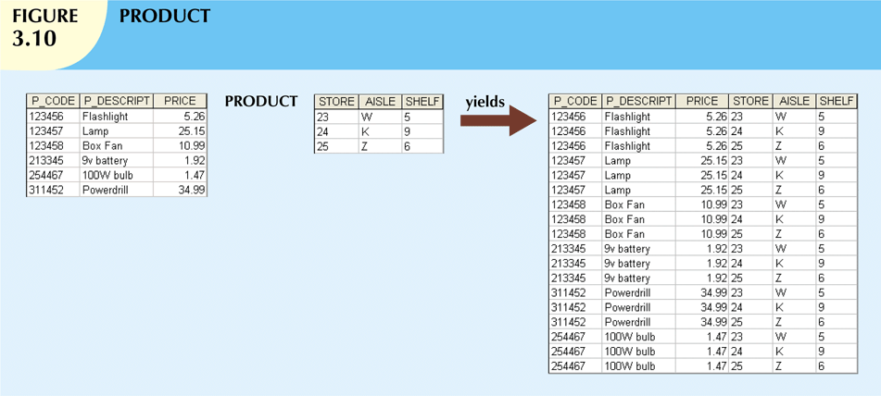
SELECT STU_FNAME, STU_LNAME
FROM STUDENT
MINUS
SELECT EMP_FNAME, EMP_LNAME
FROM EMPLOYEE
SELECT P_CODE, P_DESCRIPT, PRICE, STORE, AISLE, SHELF
FROM PRODUCT, STORE;

Slide 30
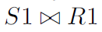
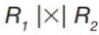
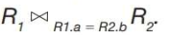
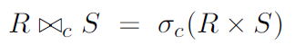
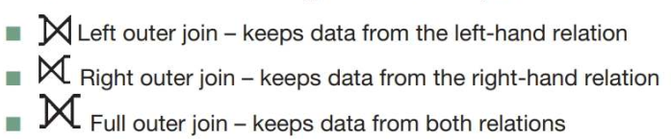
Relational Set Operators (cont’d.)
Natural Join
Links tables by selecting rows with common values in common attribute(s). If the two relations have no attributes in common, is simply the cross-product.
Equijoin
Links tables on the basis of an equality condition that compares specified columns
or
Theta join
Any other comparison operator is used
A ⋈ B
Outer join
Matched pairs are retained, and any unmatched values in other table are left null
θ

Slide 31
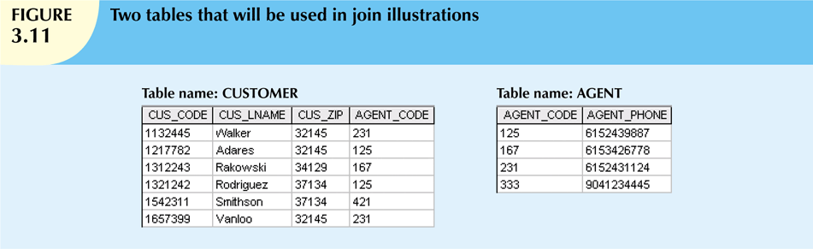
Natural Join Steps
SELECT * FROM CUSTOMER NATURAL JOIN AGENT

Slide 32
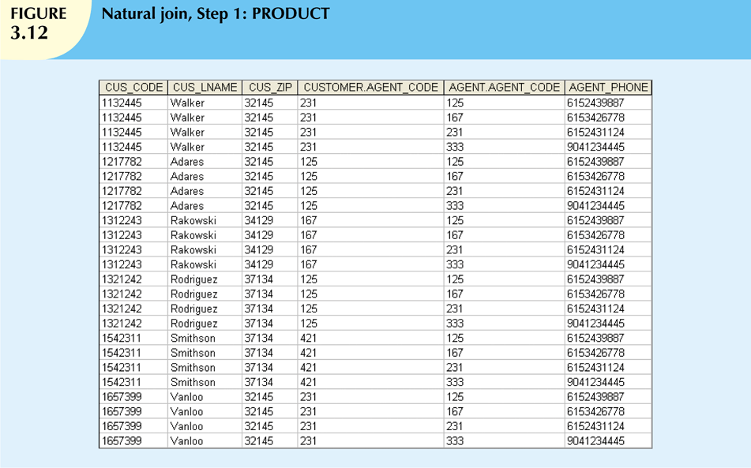

Slide 33
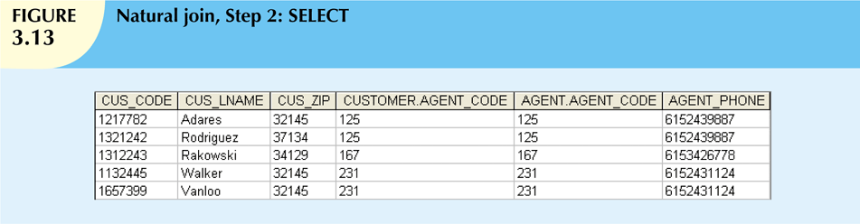
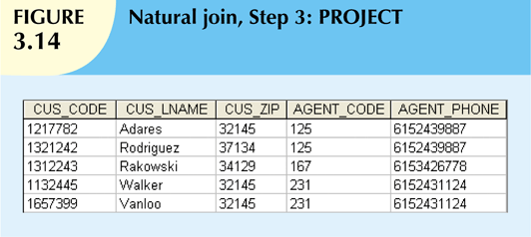

Slide 34
Equijoin
SELECT * FROM Customer
INNER JOIN Agent ON
Customer.Agent_Code= Agent.Agent_Code;

Slide 35
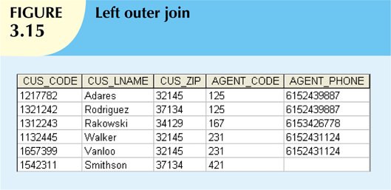
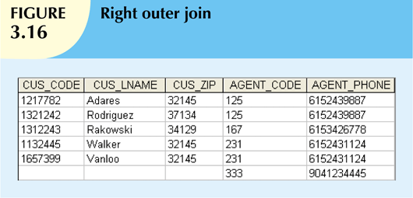
SELECT cus_code, cus_lname, cus_zip, agent_code, agent_phone FROM customer LEFT OUTER JOIN agent ON customer.agent_code = agent.agent_code;
SELECT cus_code, cus_lname, cus_zip, agent_code, agent_phone FROM customer RIGHT OUTER JOIN agent ON customer.agent_code = agent.agent_code;
* In some databases LEFT JOIN and RIGHT JOIN

Slide 36
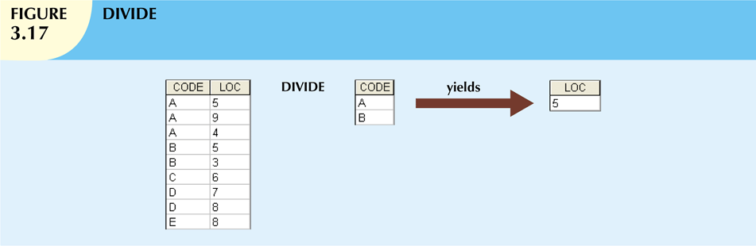
DIVISION
Another way to understand division is as follows. For each x value in (the first column of) A, consider the set of y values that appear in (the second field of) tuples of A with that x value. If this set contains (all y values in) B, the x value is in the result of A/B.

Slide 37
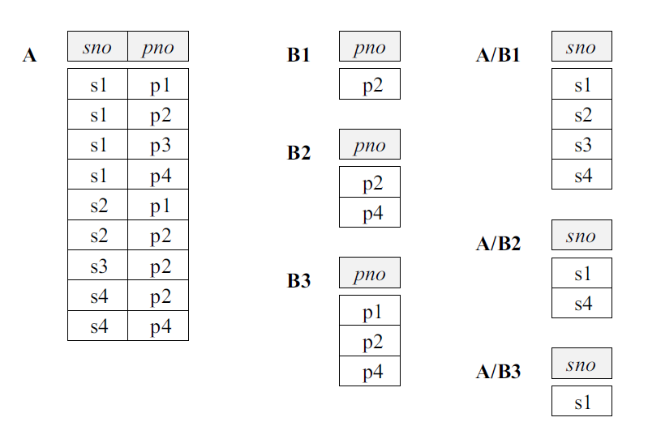
DIVISION(/) EXAMPLE
It helps to think of A as a relation listing the parts supplied by suppliers and of the B relations as listing parts. A/Bi computes suppliers who supply all parts listed in relation instance Bi.

Slide 38
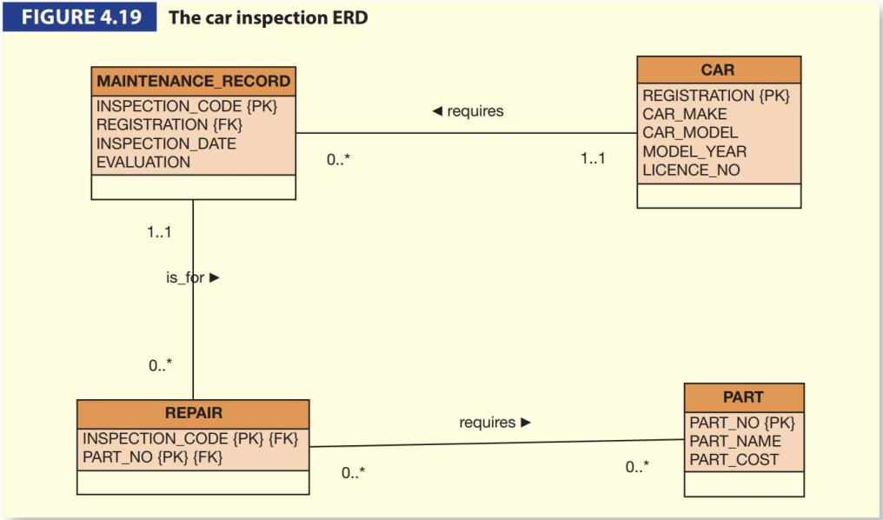
Example
A small database that stores information about the maintenance of cars (the ERD is shown in Figure 4.19). Each car is required to undergo an inspection each year to test whether it is roadworthy. After each inspection, a maintenance record is created and any repairs that are needed are recorded. A repair can require new parts to be purchased and fitted. If a car needs a repair, then the EVALUATION is set to FAIL until all the repairs are completed and then it is set to PASS.

Slide 39
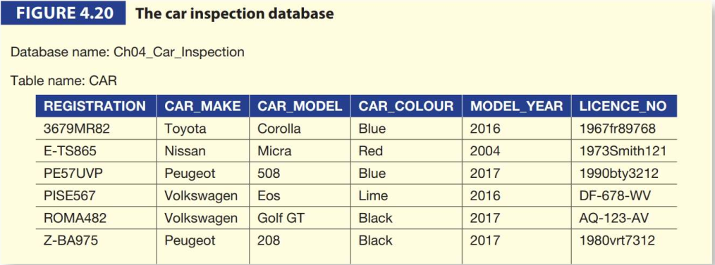
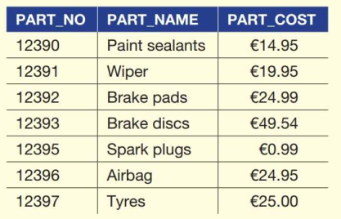
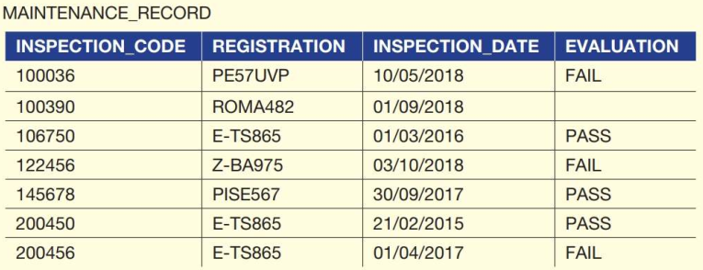
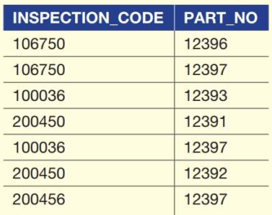

Slide 40
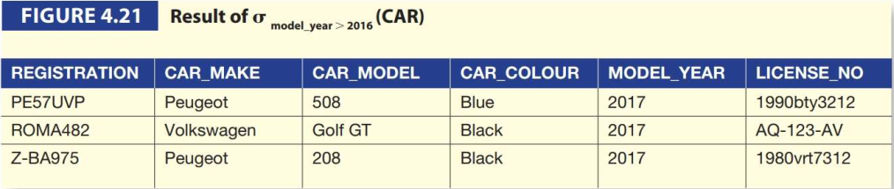
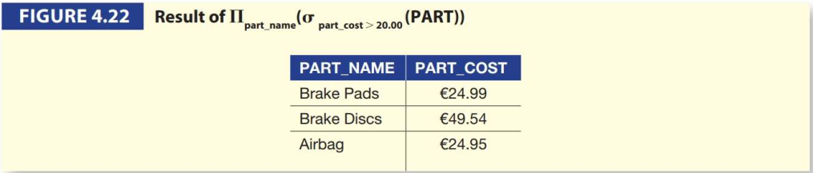
Examples
List all information about cars where the model year is after 2016.
Display all the part names and their prices where the cost of the part is greater than 20.00.

Slide 41
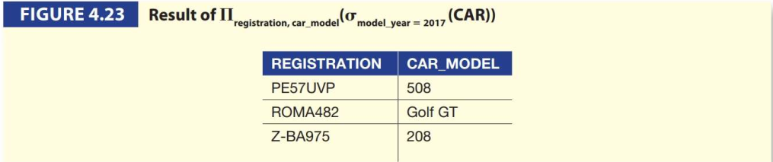
Example
List the car registration and model details and part numbers for all cars where the model year is 2017. where an inspection was carried out after 01/03/2018, which resulted in a part being required for a repair.
1st Step: The first part of the query states that we need the attributes REGISTRATION and CAR_MODEL which are located in the CAR relation. Also, we are only interested in cars whose MODEL_YEAR is 2017.

Slide 42
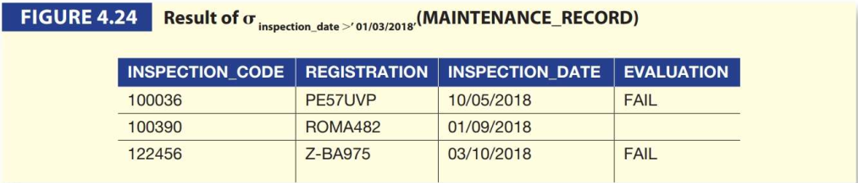
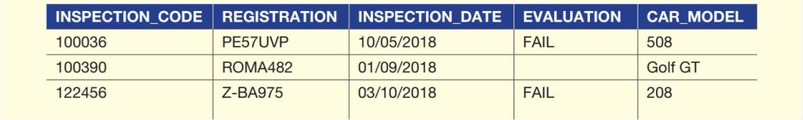
Example(Cont’d)-Assignment*
2nd Step: The next part of this query requires information about inspections that were carried out after 01/03/2018.
3rd Step: Join two result using Natural Join
*
*

Slide 43



Example(Cont’d)
4th Step: The next part of the query requires the information we have obtained so far to be restricted even further by only displaying information for cars where a part was needed for a repair.
5th Step: Finally, the original query requested that we only list ‘the car registration, model details and part numbers’.
The full expression for example 3 can be writte as:

Slide 44
Rename
Notation:
ρ _{X} (R)
Ex: “Find the ID and name of those instructors who earn more than the instructor whose ID is 12121.”

Slide 45
Relational Calculus
Tuple Relational Calculus(Codd, 1072)
Domain Relational Calculus

Slide 46


Slide 47


Slide 48
The Data Dictionary and System Catalog
Data dictionary
Provides detailed accounting of all tables found within the user/designer-created database
Contains (at least) all the attribute names and characteristics for each table in the system
Contains metadata: data about data
System catalog
Contains metadata
Detailed system data dictionary that describes all objects within the database

Slide 49


Slide 50
Relationships within the Relational Database
1:M relationship
Relational modeling ideal
Should be the norm in any relational database design
1:1 relationship
Should be rare in any relational database design
M:N relationships
Cannot be implemented as such in the relational model
M:N relationships can be changed into 1:M relationships

Slide 51

The 1:M Relationship
Relational database norm
Found in any database environment

Slide 52


Slide 53
The 1:1 Relationship
One entity related to only one other entity, and vice versa
Sometimes means that entity components were not defined properly
Could indicate that two entities actually belong in the same table
Certain conditions absolutely require their use

Slide 54


Slide 55
The M:N Relationship
Implemented by breaking it up to produce a set of 1:M relationships
Avoid problems inherent to M:N relationship by creating a composite entity
Includes as foreign keys the primary keys of tables to be linked

Slide 56


Slide 57


Slide 58


Slide 59


Slide 60


Slide 61
Data Redundancy Revisited
Data redundancy leads to data anomalies
Can destroy the effectiveness of the database
Foreign keys
Control data redundancies by using common attributes shared by tables
Crucial to exercising data redundancy control
Sometimes, data redundancy is necessary

Slide 62


Slide 63
Indexes
Orderly arrangement to logically access rows in a table
Index key
Index’s reference point
Points to data location identified by the key
Unique index
Index in which the index key can have only one pointer value (row) associated with it
Each index is associated with only one table

Slide 64


Slide 65
Codd’s Relational Database Rules
In 1985, Codd published a list of 12 rules to define a relational database system
Products marketed as “relational” that did not meet minimum relational standards
Even dominant database vendors do not fully support all 12 rules

Slide 66
Codd’s Rules
Rule 0: The foundation rule:
For any system that is advertised as, or claimed to be, a relational data base management system, that system must be able to manage data bases entirely through its relational capabilities.
Rule 1: The information rule:
All information in a relational data base is represented explicitly at the logical level and in exactly one way – by values in tables.
Rule 2: The guaranteed access rule:
Each and every datum (atomic value) in a relational data base is guaranteed to be logically accessible by resorting to a combination of table name, primary key value and column name.
Rule 3: Systematic treatment of null values:
Null values (distinct from the empty character string or a string of blank characters and distinct from zero or any other number) are supported in fully relational DBMS for representing missing information and inapplicable information in a systematic way, independent of data type.
Rule 4: Dynamic online catalog based on the relational model:
The data base description is represented at the logical level in the same way as ordinary data, so that authorized users can apply the same relational language to its interrogation as they apply to the regular data.
Rule 5: The comprehensive data sublanguage rule:
A relational system may support several languages and various modes of terminal use (for example, the fill-in-the-blanks mode). However, there must be at least one language whose statements are expressible, per some well-defined syntax, as character strings and that is comprehensive in supporting all of the following items:
Data definition.
View definition.
Data manipulation (interactive and by program).
Integrity constraints.
Authorization.
Transaction boundaries (begin, commit and rollback).

Slide 67
Codd’s Rules(contd)
Rule 6: The view updating rule:
All views that are theoretically updatable are also updatable by the system.
Rule 7: Relational Operations Rule / Possible for high-level insert, update, and delete:
The capability of handling a base relation or a derived relation as a single operand applies not only to the retrieval of data but also to the insertion, update and deletion of data.
Rule 8: Physical data independence:
Application programs and terminal activities remain logically unimpaired whenever any changes are made in either storage representations or access methods.
Rule 9: Logical data independence:
Application programs and terminal activities remain logically unimpaired when information-preserving changes of any kind that theoretically permit unimpairment are made to the base tables.
Rule 10: Integrity independence:
Integrity constraints specific to a particular relational data base must be definable in the relational data sublanguage and storable in the catalog, not in the application programs.
Rule 11: Distribution independence:
The end-user must not be able to see that the data is distributed over various locations. Users should always get the impression that the data is located at one site only.
Rule 12: The nonsubversion rule:
If a relational system has a low-level (single-record-at-a-time) language, that low level cannot be used to subvert or bypass the integrity rules and constraints expressed in the higher level relational language (multiple-records-at-a-time).

Slide 68
Summary
Tables are basic building blocks of a relational database
Keys are central to the use of relational tables
Keys define functional dependencies
Superkey
Candidate key
Primary key
Secondary key
Foreign key

Slide 69
Summary (cont’d.)
Each table row must have a primary key that uniquely identifies all attributes
Tables are linked by common attributes
The relational model supports relational algebra functions
SELECT, PROJECT, JOIN, INTERSECT UNION, DIFFERENCE, PRODUCT, DIVIDE
Good design begins by identifying entities, attributes, and relationships
1:1, 1:M, M:N

